Slide 1













Outline
Huangxun Chen, Chenyu Huang, Qianyi Huang, Qian Zhang, Wei Wang. "ECGadv: Generating Adversarial Electrocardiogram to Misguide Arrhythmia Classiﬁcation System.", AAAI 2020.
Internet-of-Thing Systems
Physical World
Spoofing
Adversary
Spoofing Issue in IoT Sensing
(ECGadv)
Electrocardiogram (ECG)
Notes:
The final part of this thesis is about spoofing issue in IoT sensing.
In this part, we explore adversarial spooﬁng attacks on the DNN-powered ECG diagnosis system.

Slide 2
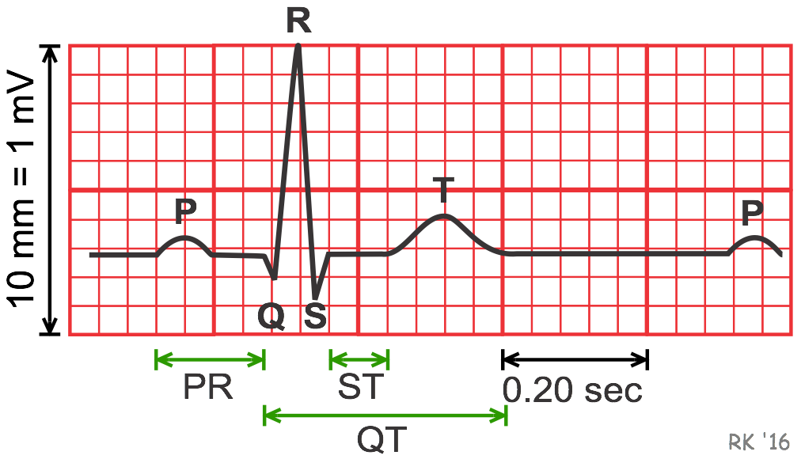
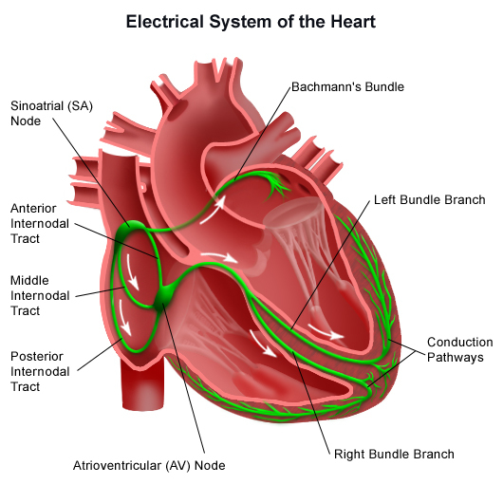

Electrocardiogram (ECG) and Cardiac Disorders
Electrocardiogram (ECG)
DNNs-powered approaches has achieved parity with cardiologists on ECG classiﬁcation and diagnosis.
Sensing Layer
Processing Layer
DNN
Electrocardiogram (ECG)
Notes:
ECG is an important tool to diagnose a wide spectrum of cardiac disorders, which are the leading health problem and cause of death worldwide by statistics.
Noweadays, there are many portable ECG recoding devices, such as ECG patches and smartwatches.
Recently, there is a trend to use DNN system for ECG classification, because it has achieved parity with cardiologists on ECG classiﬁcation.
Given enormous costs of healthcare, it is tempting to replace expensive manual ECG examining of experts with a cheap and highly accurate deep learning system.

Slide 3
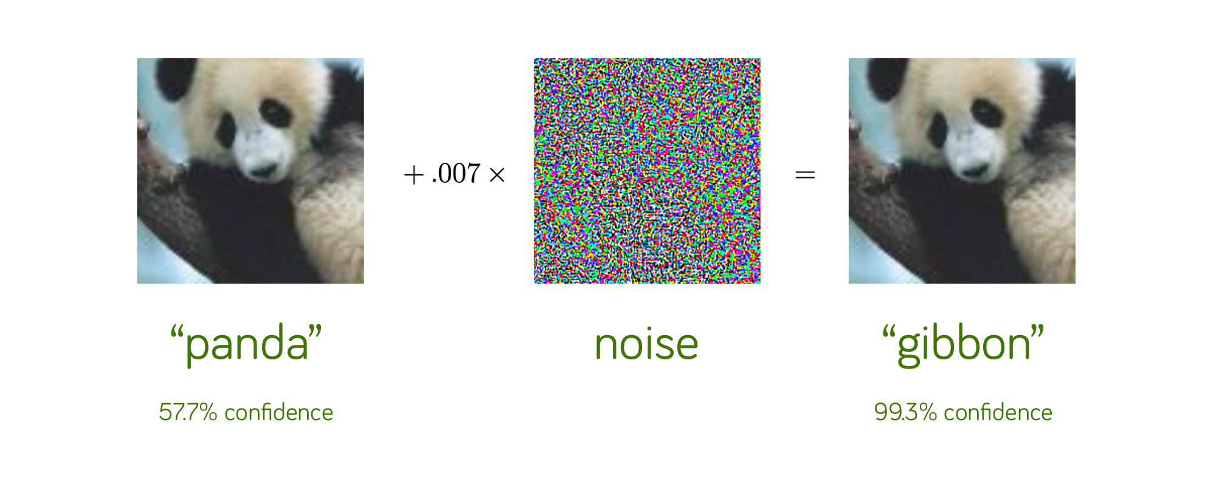
Adversarial Attacks to DNN Image Classifiers
Task Decision Boundary
Model Decision Boundary
“Gibbon”
Adversarial Example!
“Panda”
“Gibbon”
Notes:
Some literatures have shown that it is possible to attack a DNN-based image classiﬁer.
To illustrate it, we use panda and gibbon as examples, the DNN model will be trained to have a decision boundary between two classes. However, it is not 100% accurate. There are some blind spots. There may be some sample that looks similiar to panda but misclassified as gibbon. We call them adversarial examples. And an adversary will use efficient strategy to find them to cheat the system.

Slide 4
Investigate the Spoofing Feasibility in ECG Classification System
Spoofing
Spoofing
Notes:
With DNN’s increasing adoption in ECG diagnosis, its potential vulnerability to ‘adversarial examples’ also arouses public concerns.
It is important to eliminate the blind spots of such systems because people’s health and life count on them.
Thus, we would like to ….

Slide 5
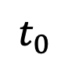

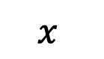


Attack Goal
Given an m-class ECG classifier: $g: 𝒳→𝒴$, $Z\left(∙\right)is logits$, an adversary
generates adversarial example $x_{adv}$ , so that $g\left(x_{adv}\right)=t$ (targeted attack)
ECG classifier
$$x$$
$$t_{0}$$
$x_{adv}$
$$t$$
Notes:
Our attack goal can be fomulated as follows:
an adversary tried to generate adv to mislead the classfier output the result that he desires.

Slide 6
Case I: When the DNN model is located remotely…
Case I
Spoofing
Spoofing
Notes:
For the case I, the user uploads the data collected by ECG patches to the remote cloud which has rich computation resources.
The adversary can access the ECG recordings and corrupt them by adding perturbations. One possible case is a doctor who can access patients’ ECGs and have monetary incentive to manipulate them to fool the checking system of insurance companies.
The adversary desires the data perturbations be effective to mislead the system but also sufﬁciently subtle that they are imperceptible to other people/experts.

Slide 7
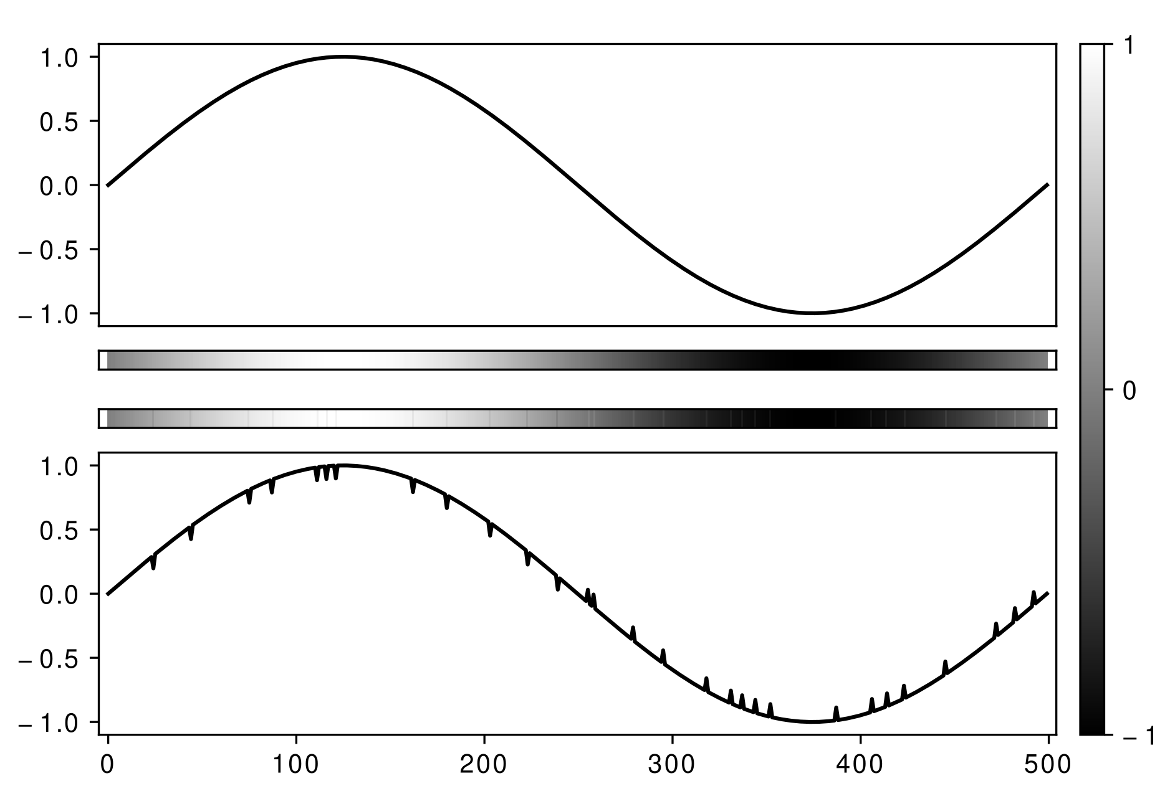
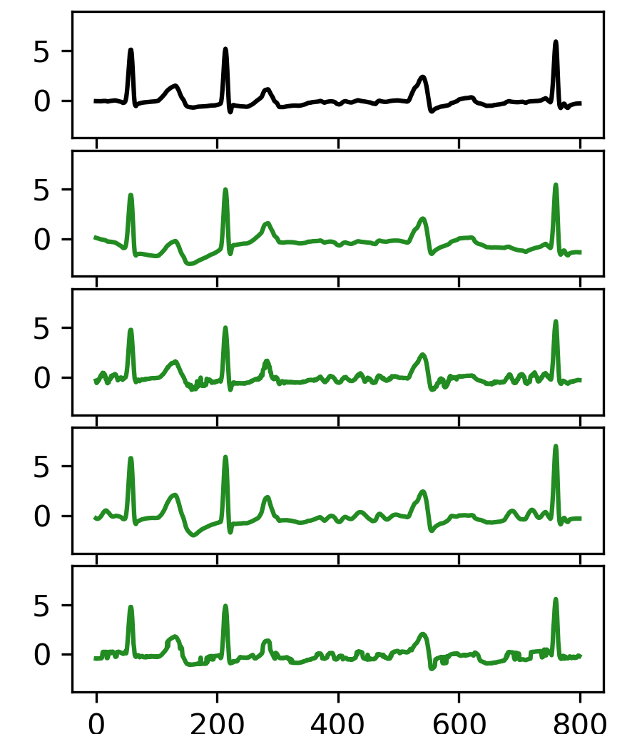
Human Vision Perception
Original Signal
Metric: L2-norm
Humans have different perceptual sensitivities to colors and line curves.
Notes:
We found that simply applying existing image-targeted attacks on ECG recordings generates suspicious adversarial instances.
because in image domain, they used Lp norm to encourage visual imperceptibility.
However, human has …
when two data arrays are visualized as line curves, their differences are more prominent rather than those visualized as gray-scale images.
L-p norm is unsuitable for ECG recordings.

Slide 8
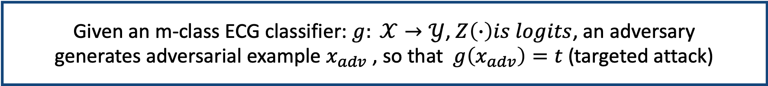
Leverage Smoothness Metric to Produce Imperceptible Attacks
Attack goal
Given an m-class ECG classifier: $g: 𝒳→𝒴$, $Z\left(∙\right)is logits$, an adversary
generates adversarial example $x_{adv}$ , so that $g\left(x_{adv}\right)=t$ (targeted attack)
Attack Strategy
Original Signal, Class: A
$$minimize D\left(x, x_{adv}\right)+c∙f_{g}(x_{adv})$$
$$where f_{g}\left(x_{adv}\right)=(\max_{i≠t}(Z(x_{adv})_{i})−Z(x_{adv})_{t})^{+}$$
Similarity metric: Smoothness of perturbation $δ$
Metric: Smoothness, Class: N
$$D\left(x, x_{adv}\right)= d_{smooth}\left(δ\right)=var\left(diff\left(δ\right)\right)$$
$diff\left(δ\right)= δ_{i}−δ_{i−1}, i=1,2,…, n$; $δ=x_{adv}−x$
Notes:
Fg is objective function, which is to push the sample across the model decision boundary.
Smoothness metric d smooth quantiﬁes the smoothness of perturbation(δ) by measuring the variation of the difference between neighbouring points of perturbation.
The smaller the variation, the smoother the perturbation.
By adopting smoothness metric rather than l2 norm, we generate imperceptible adversarial ECGs.

Slide 9
Performance - Imperceptibility Test (57 AMT users)
Which adversarial example is more similar to original signal?
Notes:
We recruit volunteers on AMT to test our system.

Slide 10
Case II: When the DNN model is located locally…
Spoofing
Spoofing
Case II
Notes:
The adversary may not be able to access the ECGs directly or they want to fool the system without leaving digital tampering footage. Thus, the attackers inject perturbation to on-the-ﬂy ECGs by physical process. Such attacks can be achieved by EMI signal injection.

Slide 11

Cooperate Time-domain Skewing and Filtering
Attack goal
Given an m-class ECG classifier: $g: 𝒳→𝒴$, $Z\left(∙\right)is logits$, an adversary
generates adversarial example $x_{adv}$ , so that $g\left(x_{adv}\right)=t$ (targeted attack)
Attack Strategy
1. Cooperate time domain skewing
Given a distribution $T$ of transformation function $tf$:
minimize$E_{tf\sim T}\left[D\left(tf(x), {tf(x}_{adv})\right)\right]+c∙E_{tf\sim T}[−logP\left(y_{t} | tf\left(x_{adv}\right)\right)]$
2. Cooperate filtering
$x_{adv}=x+h\left(x_{perturb}\right), h(∙)$ is a rectangular filter
Notes:
Two challenges:
there is skewing in time domain between perturbation and ECG, since the attacker hardly knows ECG’s exact start time.
Filtering of ECG devices, as a standard process to combat noise, will be applied on injected perturbation and may impair its attack effect.
We takes these two factors into consideration when designing attack strategy.
To handle time domain skewing, we model it as shifting transformation and optimize expectation over such transformation to search effective adversarial examples.
To handle filtering, we on purpose zero out the respective frequency component in perturbation so that it can be resistant to filters.

Slide 12
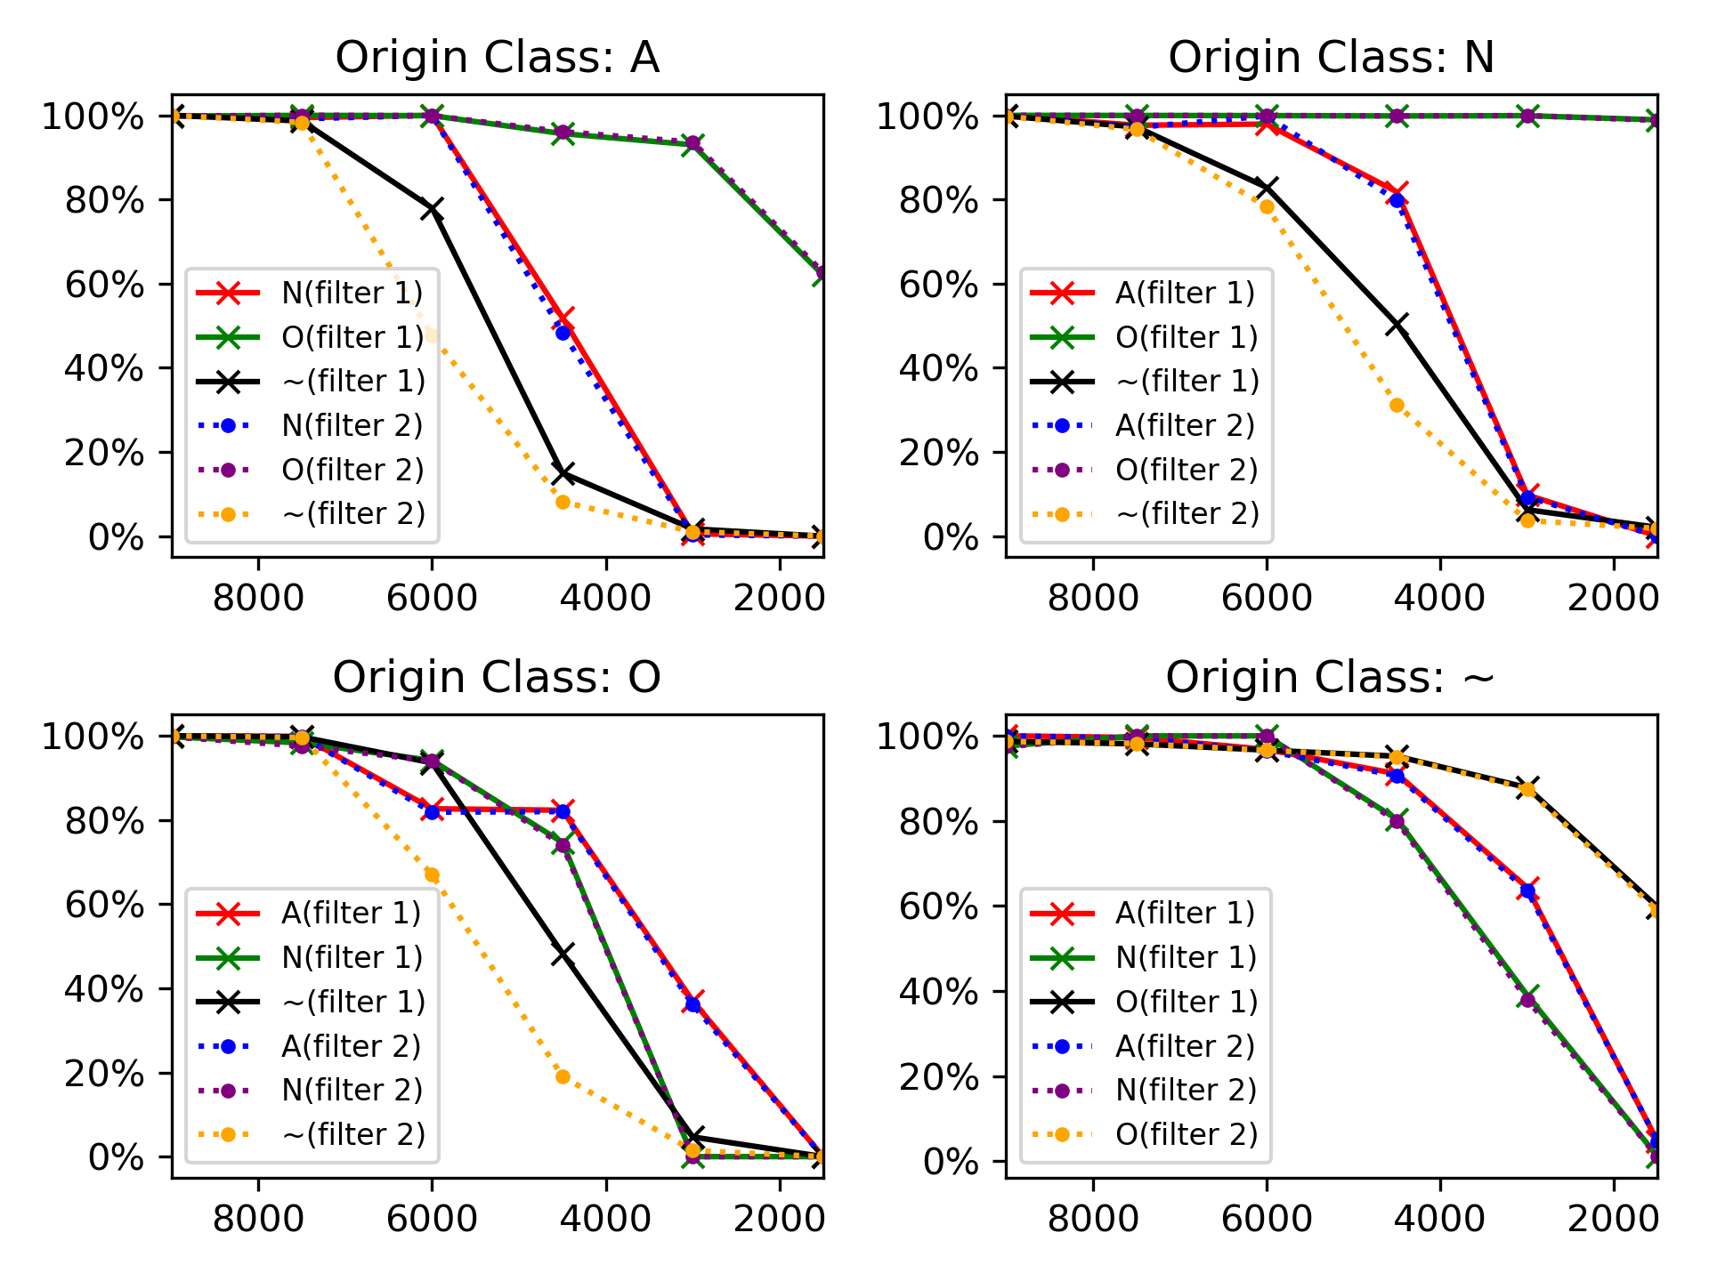
Performance - Success Attack Rates with Different Attack Duration
Attack duration: the part of an ECG affected by perturbation
Filter 1: Rectangular ﬁlter; Filter 2: A high-pass Butterworth ﬁlter (0.05Hz cutoff) + Notch ﬁlters (50/60Hz)
Notes:
two third.

Slide 13
Quick Summary
We takes a step to thoroughly explore adversarial attacks on the DNN-powered ECG diagnosis system.
We analyze the properties of ECGs to design effective attacks schemes, ECGadv under two attacks models respectively.
Our results demonstrate the blind spots of DNN-powered diagnosis systems under adversarial attacks, which calls attention to adequate countermeasures.

